Slide 1
Cryptography (2022 Fall) plain RSA signature, RSA-FDH, hash-and-sign, garbled circuit
LiangFeng Zhang
zhanglf@shanghaitech.edu.cn
SIST, ShanghaiTech

Slide 2
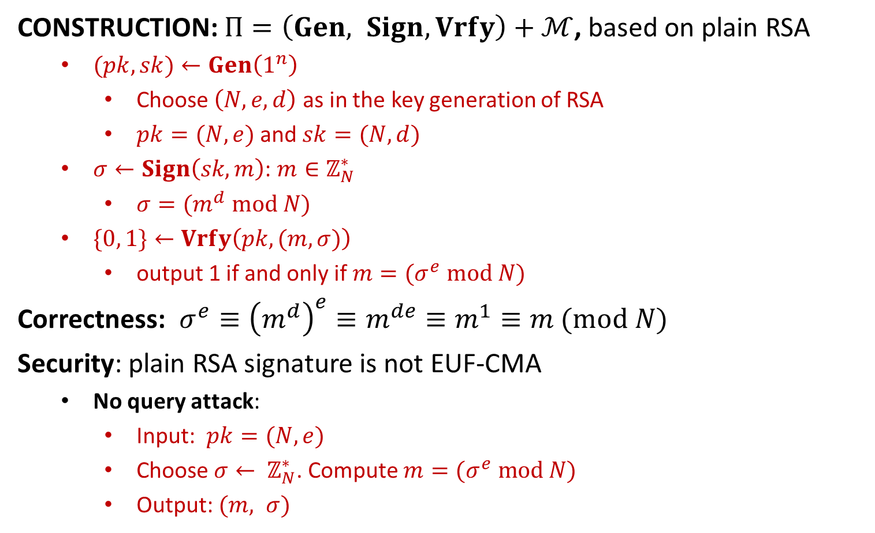
Plain RSA Signature
CONSTRUCTION: $Π=\left(Gen, Sign, Vrfy\right)+ℳ$, based on plain RSA
$(pk,sk)←Gen\left(1^{n}\right)$
Choose $\left(N,e,d\right)$ as in the key generation of RSA
$pk=(N, e)$and $sk=(N, d)$
$σ←Sign\left(sk, m\right)$: $m∈ℤ_{N}^{∗}$
$σ=(m^{d} mod N)$
$\{0, 1\}←Vrfy\left(pk, (m,σ)\right)$
output 1 if and only if $m=(σ^{e} mod N)$
Correctness: $σ^{e}≡{\left(m^{d}\right)}^{e}≡m^{de}≡m^{1}≡m (mod N)$
Security: plain RSA signature is not EUF-CMA
No query attack:
Input: $pk=(N,e)$
Choose $σ← ℤ_{N}^{∗}$. Compute $m=(σ^{e} mod N)$
Output: $(m, σ)$

Slide 3
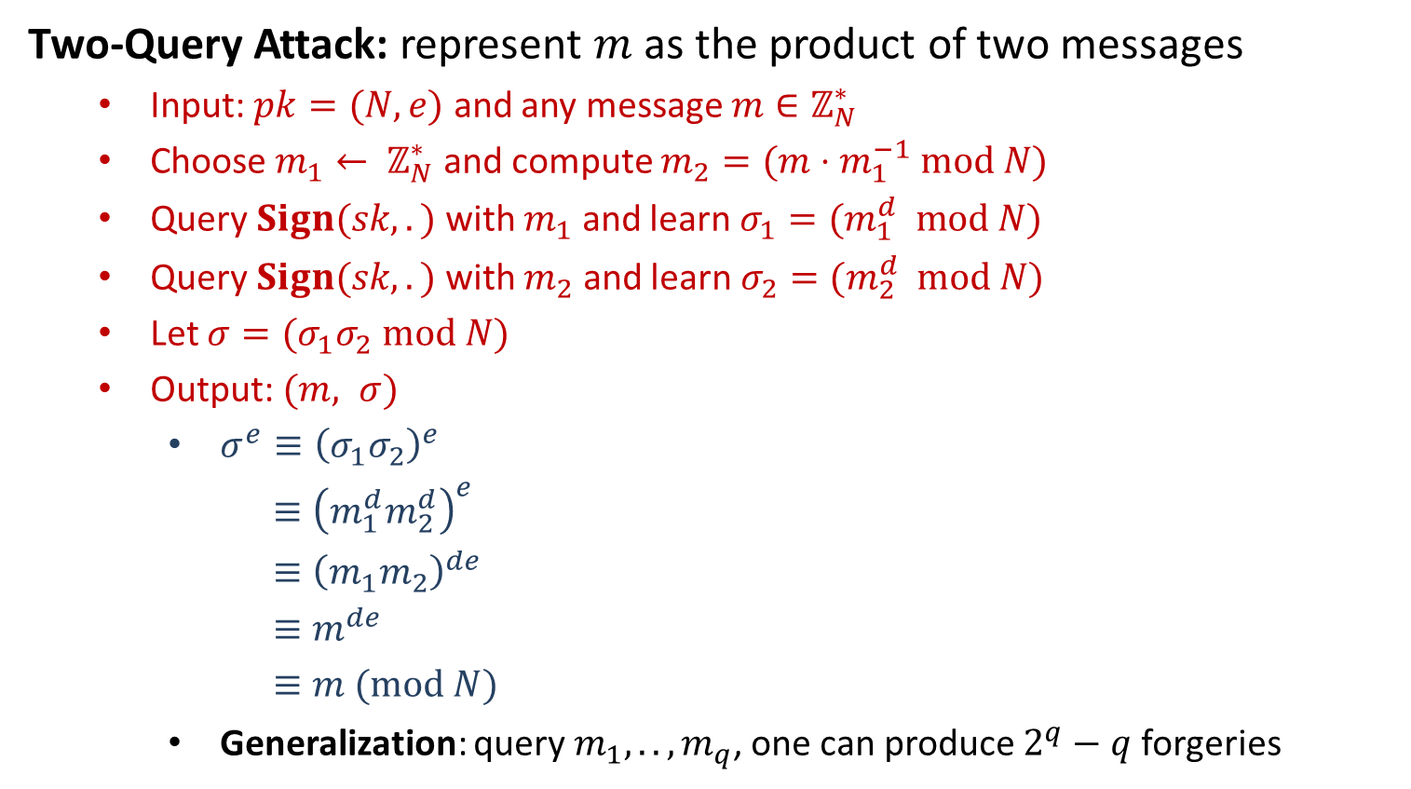
Plain RSA Signature
Two-Query Attack: represent $m$ as the product of two messages
Input: $pk=(N,e)$ and any message $m∈ℤ_{N}^{∗}$
Choose $m_{1}← ℤ_{N}^{∗}$ and compute $m_{2}=(m⋅m_{1}^{−1} mod N)$
Query $Sign(sk, .)$ with $m_{1}$ and learn $σ_{1}=(m_{1}^{d} mod N)$
Query $Sign(sk, .)$ with $m_{2}$ and learn $σ_{2}=(m_{2}^{d} mod N)$
Let $σ=(σ_{1}σ_{2} mod N)$
Output: $(m, σ)$
$σ^{e}≡{\left(σ_{1}σ_{2}\right)}^{e}$
$≡{\left(m_{1}^{d}m_{2}^{d}\right)}^{e}$
$≡{\left(m_{1}m_{2}\right)}^{de}$
$≡m^{de}$
$≡m (mod N)$
Generalization: query $m_{1},..,m_{q}$, one can produce $2^{q}−q$ forgeries

Slide 4
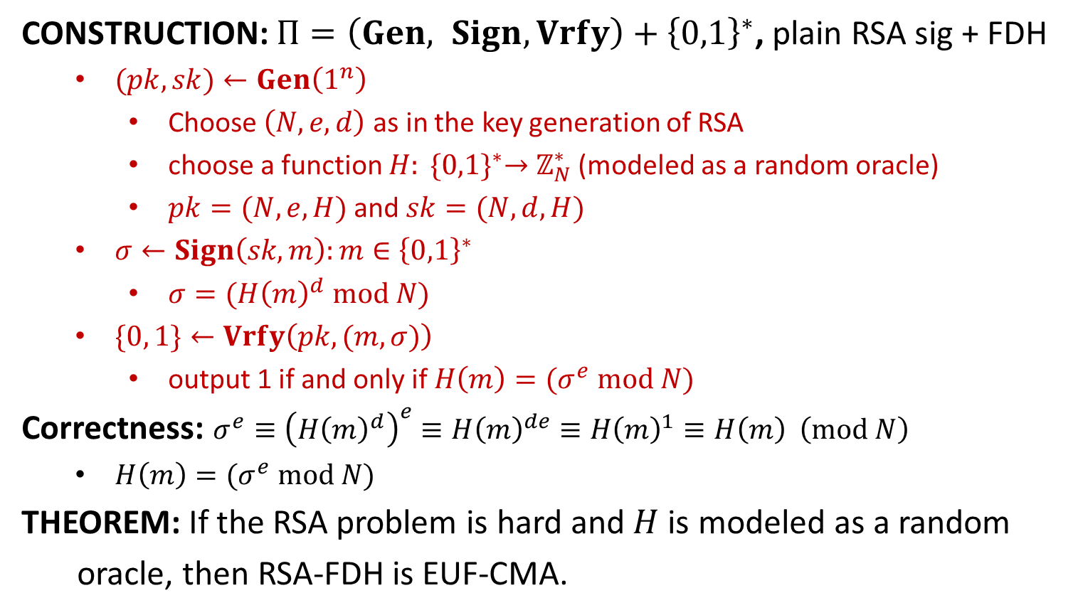
RSA-FDH (full-domain hash)
CONSTRUCTION: $Π=\left(Gen, Sign, Vrfy\right)+{\left\{0,1\right\}}^{∗}$, plain RSA sig + FDH
$(pk,sk)←Gen\left(1^{n}\right)$
Choose $\left(N,e,d\right)$ as in the key generation of RSA
choose a function $H: {\{0,1\}}^{∗}→$ $ℤ_{N}^{∗}$ (modeled as a random oracle)
$pk=(N, e, H)$and $sk=(N, d,H)$
$σ←Sign\left(sk, m\right):m∈{\left\{0,1\right\}}^{∗}$
$σ=({H\left(m\right)}^{d} mod N)$
$\{0, 1\}←Vrfy\left(pk, (m,σ)\right)$
output 1 if and only if $H\left(m\right)=(σ^{e} mod N)$
Correctness: $σ^{e}≡{\left({H\left(m\right)}^{d}\right)}^{e}≡{H\left(m\right)}^{de}≡{H\left(m\right)}^{1}≡H\left(m\right) \left(mod N\right)$
$H\left(m\right)=(σ^{e} mod N)$
THEOREM: If the RSA problem is hard and$H$is modeled as a random
oracle, then RSA-FDH is EUF-CMA.

Slide 5
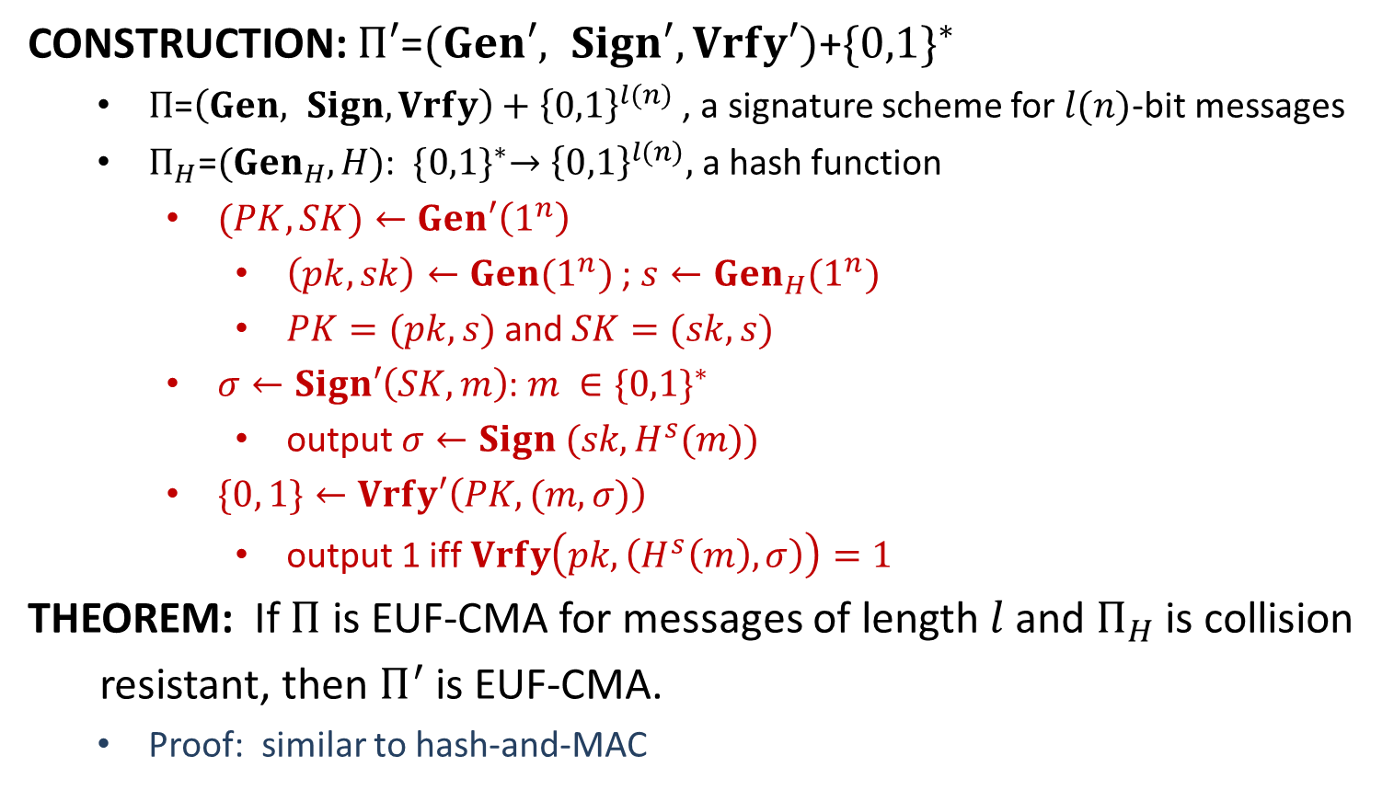
Hash-and-Sign
CONSTRUCTION: $Π′\text{=}(Gen′, Sign′, Vrfy′)\text{+}{\{0,1\}}^{∗}$
$Π\text{=}\left(Gen, Sign, Vrfy\right)+{\left\{0,1\right\}}^{l(n)}$ , a signature scheme for $l(n)$-bit messages
$Π_{H}\text{=}({Gen}_{H},H)$: ${\{0,1\}}^{∗}→{\left\{0,1\right\}}^{l(n)},$ a hash function
$(PK,SK)←Gen′\left(1^{n}\right)$
$\left(pk,sk\right)←Gen(1^{n})$; $s←{Gen}_{H}(1^{n})$
$PK=(pk, s)$and $SK=(sk, s)$
$σ←Sign′\left(SK, m\right)$: $m ∈{\{0,1\}}^{∗}$
output $σ←Sign (sk, H^{s}(m))$
$\{0, 1\}←Vrfy′\left(PK, (m,σ)\right)$
output 1 iff $Vrfy\left(pk, \left(H^{s}\left(m\right), σ\right)\right)=1$
THEOREM: If $Π$ is EUF-CMA for messages of length$l$and $Π_{H}$ is collision
resistant, then $Π^{′}$ is EUF-CMA.
Proof: similar to hash-and-MAC

Slide 7


Secure Communication
“Transfer $1000 from Alice to David”
Alice
Bob (bank)
Charlie
There are two parties, Alice and Bob, who want to communicate securely.
There is an adversary Charlie, who may wiretap or tamper with the channel.
To ensure secure communication, two fundamental properties are required:
Confidentiality: private communication channel
Symmetric-key Cryptosystem and Public-key Cryptosystem
Integrity: authenticated communication channel
Message Authentication Codes and Digital Signatures

Slide 8




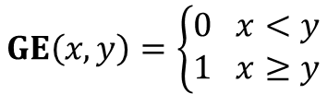


Millionaires’ Problem
Who is wealthier?
$$GE\left(x,y\right)=\left\{\begin{aligned}0 x<y \\ 1 x≥y\end{aligned}\right.$$
Millionaire Alice
$$GE\left(x,y\right)=?$$
Millionaire Bob
$x$ million dollars
$y$ million dollars
I have $x$ million dollars
$$GE\left(x,y\right)=1$$
Millionaire Alice
Alice: Bob learns too much about me?!
Millionaire Bob
$x$ million dollars
Can we learn $GE(x,y)$ without revealing
$x$ or$y$to the other person?
$y$ million dollars
A.C.C. Yao 1982
Turing Award 2000

Slide 9
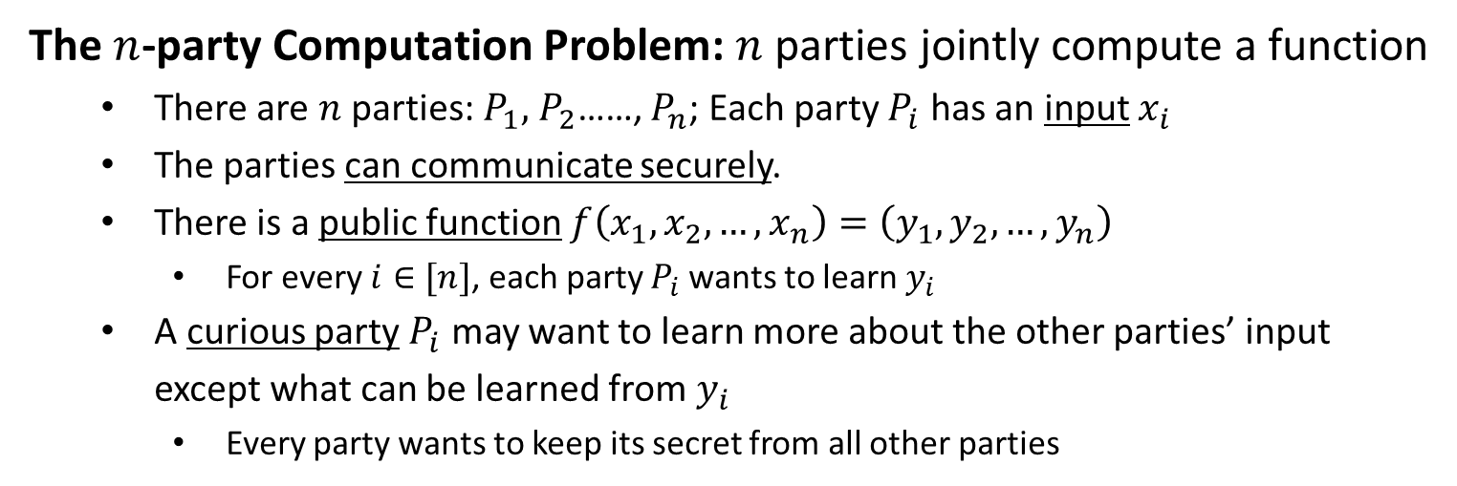
Secure Computation
The $n$-party Computation Problem: $n$ parties jointly compute a function
There are $n$ parties: $P_{1},$ $P_{2}$……, $P_{n}$; Each party $P_{i}$ has an input $x_{i}$
The parties can communicate securely.
There is a public function $f\left(x_{1},x_{2},…,x_{n}\right)=\left(y_{1}, y_{2},…, y_{n}\right)$
For every $i∈[n]$, each party $P_{i}$ wants to learn $y_{i}$
A curious party $P_{i}$ may want to learn more about the other parties’ input except what can be learned from $y_{i}$
Every party wants to keep its secret from all other parties

Slide 11

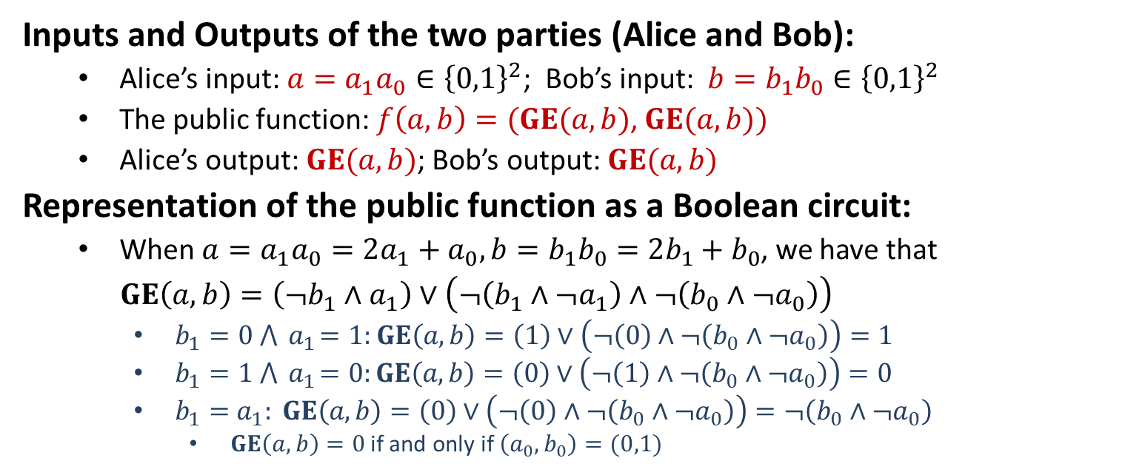



Yao’s Garbled Circuit for 2PC
$$a=a_{1}a_{0}$$
$$b=b_{1}b_{0}$$
$$GE(a,b)$$
$$GE(a,b)$$
Alice
Bob
Inputs and Outputs of the two parties (Alice and Bob):
Alice’s input: $a=a_{1}a_{0}∈{\left\{0,1\right\}}^{2}$; Bob’s input: $b=b_{1}b_{0}∈{\left\{0,1\right\}}^{2}$
The public function: $f\left(a,b\right)=(GE(a,b)$, $GE(a,b))$
Alice’s output: $GE(a,b)$; Bob’s output: $GE(a,b)$
Representation of the public function as a Boolean circuit:
When $a=a_{1}a_{0}=2a_{1}+a_{0}, b=b_{1}b_{0}=2b_{1}+b_{0}$, we have that
$GE\left(a,b\right)=\left(¬b_{1}∧a_{1}\right)∨\left(¬\left(b_{1}∧¬a_{1}\right)∧¬\left(b_{0}∧¬a_{0}\right)\right)$
$b_{1}=0 ⋀{ a}_{1}=1:$ $GE\left(a,b\right)=\left(1\right)∨\left(¬\left(0\right)∧¬\left(b_{0}∧¬a_{0}\right)\right)=1$
$b_{1}=1 ⋀{ a}_{1}=0:GE\left(a,b\right)=\left(0\right)∨\left(¬\left(1\right)∧¬\left(b_{0}∧¬a_{0}\right)\right)=0$
$b_{1}={ a}_{1}: GE\left(a,b\right)=\left(0\right)∨\left(¬\left(0\right)∧¬\left(b_{0}∧¬a_{0}\right)\right)=¬\left(b_{0}∧¬a_{0}\right)$
$GE\left(a,b\right)=0$if and only if $\left(a_{0},b_{0}\right)=(0,1)$

Slide 12


(1) Alice: $f$ $→$ Boolean Circuit $BC(f)$
$$GE\left(a,b\right)=\left(¬b_{1}∧a_{1}\right)∨\left(¬\left(b_{1}∧¬a_{1}\right)∧¬\left(b_{0}∧¬a_{0}\right)\right)$$
$$1$$
$$2$$
$$3$$
$$4$$
$$5$$
$$6$$
$$7$$
$$8$$
$$9$$
$$10$$
$$11$$
$$12$$
$$13$$
$$14$$
$$15$$
$$16$$
$$GE(a,b)$$

Slide 13
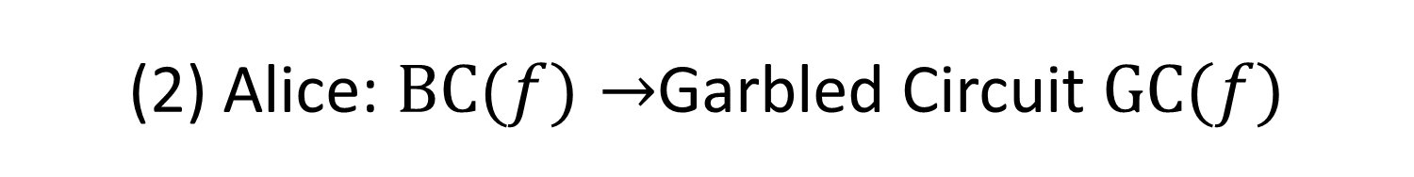
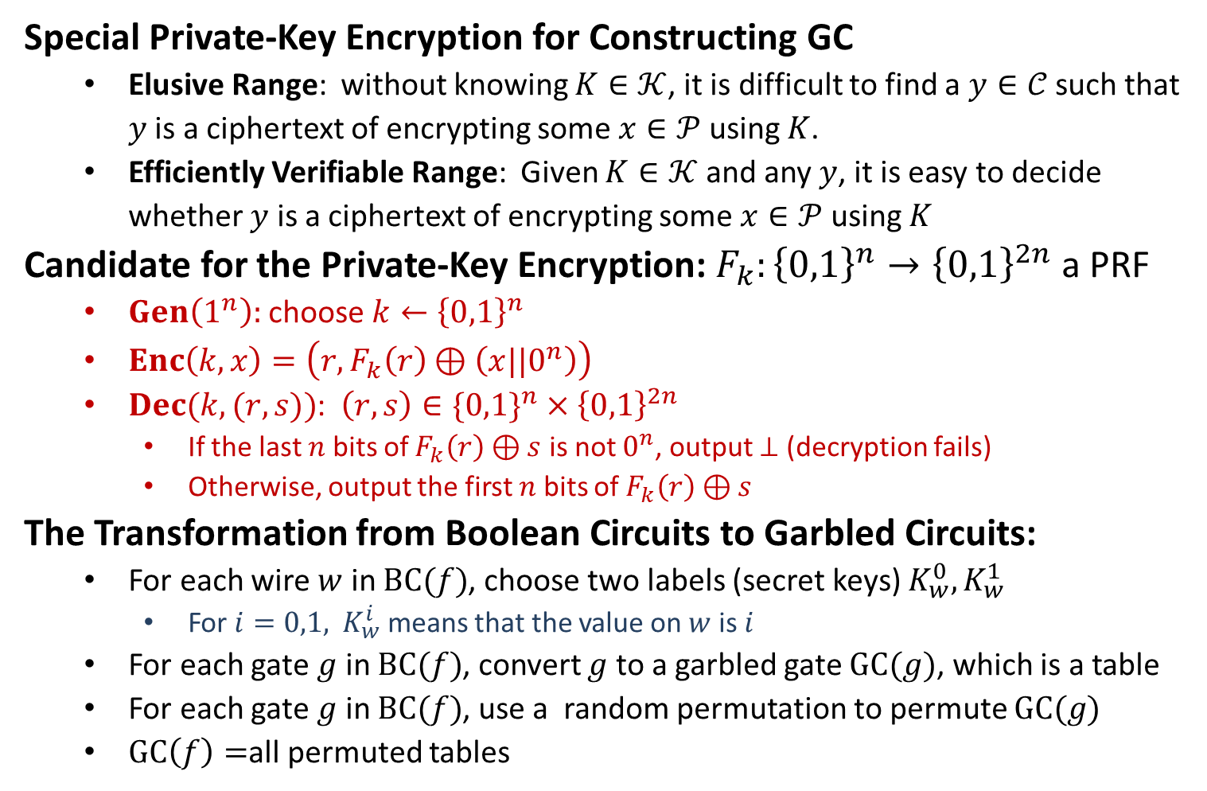
(2) Alice: $BC(f)→$Garbled Circuit $GC(f)$
Special Private-Key Encryption for Constructing GC
Elusive Range: without knowing $K∈𝒦$, it is difficult to find a $y∈𝒞$ such that $y$ is a ciphertext of encrypting some $x∈𝒫$ using $K$.
Efficiently Verifiable Range: Given $K∈𝒦$ and any $y$, it is easy to decide whether $y$ is a ciphertext of encrypting some $x∈𝒫$ using $K$
Candidate for the Private-Key Encryption:$F_{k}:{\left\{0,1\right\}}^{n}→{\left\{0,1\right\}}^{2n}$ a PRF
$Gen\left(1^{n}\right):$choose $k←{\left\{0,1\right\}}^{n}$
$Enc\left(k,x\right)=\left(r,F_{k}\left(r\right)⊕\left(x||0^{n}\right)\right)$
$Dec(k,(r,s))$: $\left(r,s\right)∈\{0,1\}^{n}×{\left\{0,1\right\}}^{2n}$
If the last $n$ bits of $F_{k}\left(r\right)⊕s$ is not $0^{n}$, output $⊥$ (decryption fails)
Otherwise, output the first $n$ bits of $F_{k}\left(r\right)⊕s$
The Transformation from Boolean Circuits to Garbled Circuits:
For each wire $w$ in $BC(f)$, choose two labels (secret keys) $K_{w}^{0}, K_{w}^{1}$
For $i=0,1,$ $K_{w}^{i}$ means that the value on $w$ is $i$
For each gate $g$ in $BC(f)$, convert $g$ to a garbled gate $GC(g)$, which is a table
For each gate $g$ in $BC(f)$, use a random permutation to permute $GC(g)$
$GC\left(f\right)=$all permuted tables

Slide 14








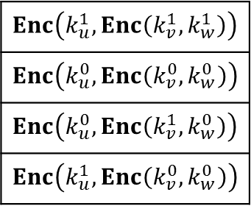


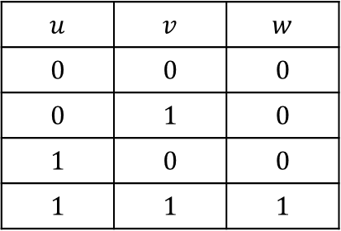

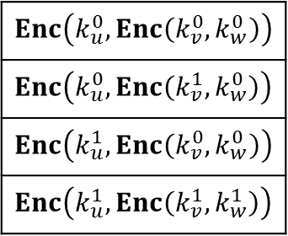

(2) Alice: $BC(f)→$Garbled Circuit $GC(f)$
$$u$$
$$v$$
$$k_{u}^{0}$$
$$k_{u}^{1}$$
$$k_{v}^{0}$$
$$k_{v}^{1}$$
$$GC(g)$$
$$∧$$
$$∧$$
$$w$$
$$k_{w}^{0} k_{w}^{1}$$
AND gate $g$
Choose labels
$$u$$ | $$v$$ | $$w$$
$$0$$ | $$0$$ | $$0$$
$$0$$ | $$1$$ | $$0$$
$$1$$ | $$0$$ | $$0$$
$$1$$ | $$1$$ | $$1$$
$$Enc\left(k_{u}^{0},Enc\left(k_{v}^{0},k_{w}^{0}\right)\right)$$
$$Enc\left(k_{u}^{0},Enc\left(k_{v}^{1},k_{w}^{0}\right)\right)$$
$$Enc\left(k_{u}^{1},Enc\left(k_{v}^{0},k_{w}^{0}\right)\right)$$
$$Enc\left(k_{u}^{1},Enc\left(k_{v}^{1},k_{w}^{1}\right)\right)$$
$$Enc\left(k_{u}^{1},Enc\left(k_{v}^{1},k_{w}^{1}\right)\right)$$
$$Enc\left(k_{u}^{0},Enc\left(k_{v}^{0},k_{w}^{0}\right)\right)$$
$$Enc\left(k_{u}^{0},Enc\left(k_{v}^{1},k_{w}^{0}\right)\right)$$
$$Enc\left(k_{u}^{1},Enc\left(k_{v}^{0},k_{w}^{0}\right)\right)$$
Truth table
Encrypted gate
Permuted Encrypted gate

Slide 15


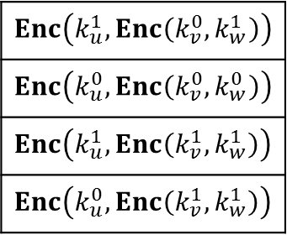

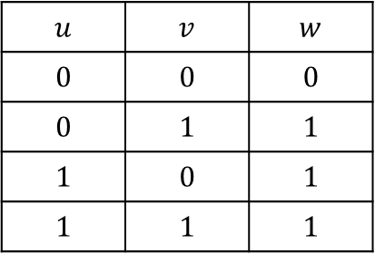
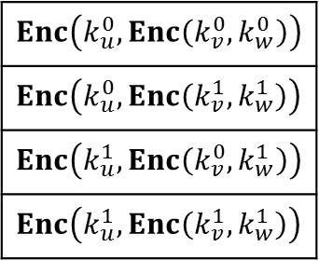
(2) Alice: $BC(f)→$Garbled Circuit $GC(f)$
$$u$$
$$v$$
$$k_{u}^{0}$$
$$k_{u}^{1}$$
$$k_{v}^{0}$$
$$k_{v}^{1}$$
$$GC(g)$$
$$∨$$
$$∨$$
$$w$$
$$k_{w}^{0} k_{w}^{1}$$
OR gate $g$
Choose labels
$$u$$ | $$v$$ | $$w$$
$$0$$ | $$0$$ | $$0$$
$$0$$ | $$1$$ | $$1$$
$$1$$ | $$0$$ | $$1$$
$$1$$ | $$1$$ | $$1$$
$$Enc\left(k_{u}^{0},Enc\left(k_{v}^{0},k_{w}^{0}\right)\right)$$
$$Enc\left(k_{u}^{0},Enc\left(k_{v}^{1},k_{w}^{1}\right)\right)$$
$$Enc\left(k_{u}^{1},Enc\left(k_{v}^{0},k_{w}^{1}\right)\right)$$
$$Enc\left(k_{u}^{1},Enc\left(k_{v}^{1},k_{w}^{1}\right)\right)$$
$$Enc\left(k_{u}^{1},Enc\left(k_{v}^{0},k_{w}^{1}\right)\right)$$
$$Enc\left(k_{u}^{0},Enc\left(k_{v}^{0},k_{w}^{0}\right)\right)$$
$$Enc\left(k_{u}^{1},Enc\left(k_{v}^{1},k_{w}^{1}\right)\right)$$
$$Enc\left(k_{u}^{0},Enc\left(k_{v}^{1},k_{w}^{1}\right)\right)$$
Truth table
Encrypted gate
Permuted Encrypted gate

Slide 16





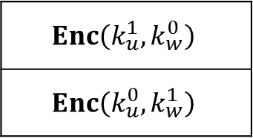

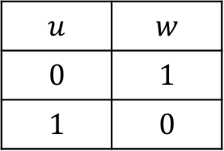

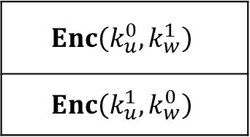

(2) Alice: $BC(f)→$Garbled Circuit $GC(f)$
$$u$$
$$k_{u}^{0} k_{u}^{1}$$
$$GC(g)$$
$$¬$$
$$¬$$
$$w$$
$$k_{w}^{0} k_{w}^{1}$$
NOT gate $g$
Choose labels
$$u$$ | $$w$$
$$0$$ | $$1$$
$$1$$ | $$0$$
$$Enc\left(k_{u}^{0},k_{w}^{1}\right)$$
$$Enc\left(k_{u}^{1},k_{w}^{0}\right)$$
$$Enc\left(k_{u}^{1},k_{w}^{0}\right)$$
$$Enc\left(k_{u}^{0},k_{w}^{1}\right)$$
Truth table
Encrypted gate
Permuted Encrypted gate

Slide 17



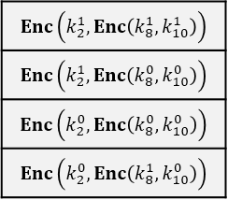
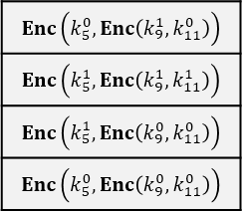


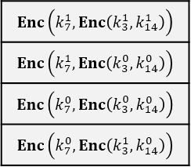
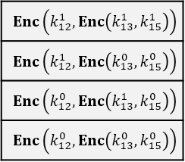
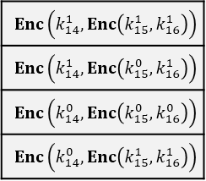



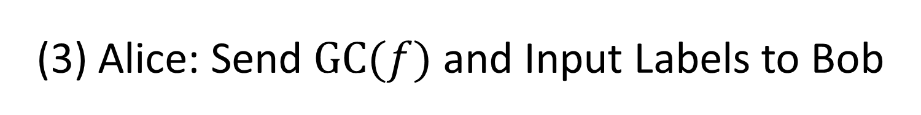









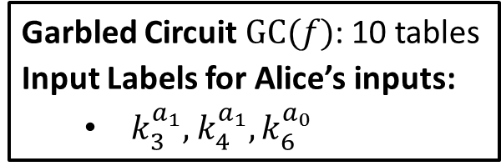




(3) Alice: Send $GC(f)$ and Input Labels to Bob
$$(k_{2}^{0},k_{2}^{1})$$
$$(k_{4}^{0},k_{4}^{1})$$
$$(k_{6}^{0},k_{6}^{1})$$
$$(k_{1}^{0},k_{1}^{1})$$
$$(k_{3}^{0},k_{3}^{1})$$
$$(k_{5}^{0},k_{5}^{1})$$
$$(k_{8}^{0},k_{8}^{1})$$
$$(k_{9}^{0},k_{9}^{1})$$
$$(k_{7}^{0},k_{7}^{1})$$
$$(k_{10}^{0},k_{10}^{1})$$
$$(k_{11}^{0},k_{11}^{1})$$
$$(k_{12}^{0},k_{12}^{1})$$
$$(k_{13}^{0},k_{13}^{1})$$
Garbled Circuit $GC(f)$: 10 tables
Input Labels for Alice’s inputs:
$k_{3}^{a_{1}},$ $k_{4}^{a_{1}}, k_{6}^{a_{0}}$
$$(k_{15}^{0},k_{15}^{1})$$
$$(k_{14}^{0},k_{14}^{1})$$
$$(k_{16}^{0},k_{16}^{1})$$

Slide 18
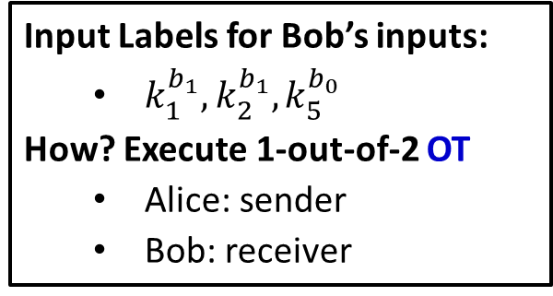
(4) Bob: Collect input labels from Alice
$$(k_{2}^{0},k_{2}^{1})$$
$$(k_{4}^{0},k_{4}^{1})$$
$$(k_{6}^{0},k_{6}^{1})$$
$$(k_{1}^{0},k_{1}^{1})$$
$$(k_{3}^{0},k_{3}^{1})$$
$$(k_{5}^{0},k_{5}^{1})$$
$$(k_{8}^{0},k_{8}^{1})$$
$$(k_{9}^{0},k_{9}^{1})$$
$$(k_{7}^{0},k_{7}^{1})$$
$$(k_{10}^{0},k_{10}^{1})$$
$$(k_{11}^{0},k_{11}^{1})$$
$$(k_{12}^{0},k_{12}^{1})$$
$$(k_{13}^{0},k_{13}^{1})$$
Input Labels for Bob’s inputs:
$k_{1}^{b_{1}},$ $k_{2}^{b_{1}}, k_{5}^{b_{0}}$
How? Execute 1-out-of-2 OT
Alice: sender
Bob: receiver
$$(k_{15}^{0},k_{15}^{1})$$
$$(k_{14}^{0},k_{14}^{1})$$
$$(k_{16}^{0},k_{16}^{1})$$

Slide 19
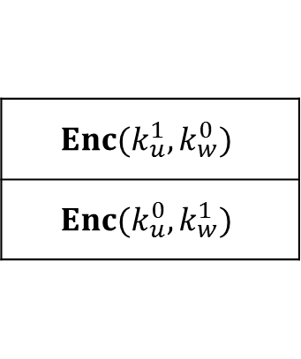

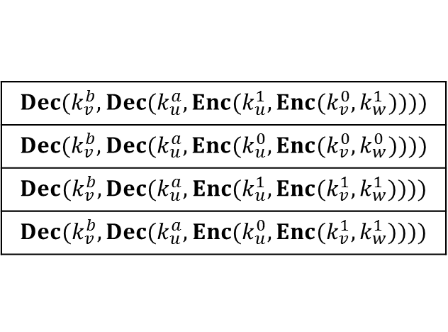
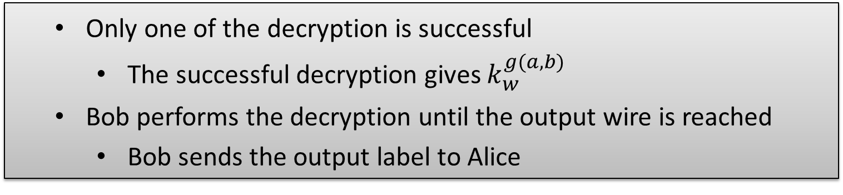

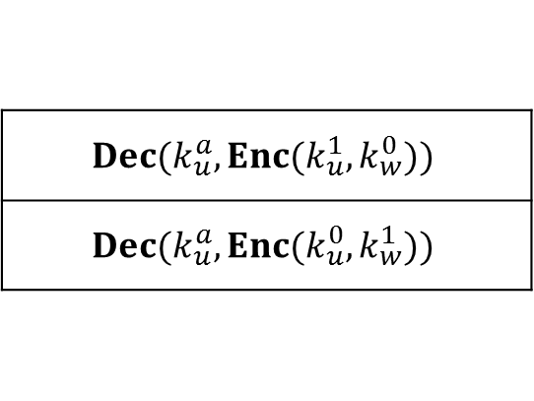


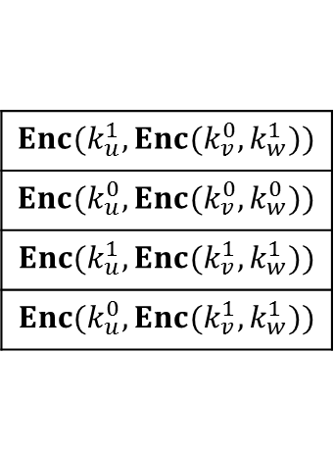

(5) Bob: Evaluate the Garbled Circuit
EXAMPLE: How to decrypt the permuted encrypted table with $(k_{u}^{a},k_{v}^{b})$
EXAMPLE: How to decrypt the permuted encrypted table with $k_{u}^{a}$
$$Enc(k_{u}^{1},Enc(k_{v}^{0},k_{w}^{1}))$$
$$Enc(k_{u}^{0},Enc(k_{v}^{0},k_{w}^{0}))$$
$$Enc(k_{u}^{1},Enc(k_{v}^{1},k_{w}^{1}))$$
$$Enc(k_{u}^{0},Enc(k_{v}^{1},k_{w}^{1}))$$
$$Dec(k_{v}^{b},Dec(k_{u}^{a},Enc(k_{u}^{1},Enc(k_{v}^{0},k_{w}^{1}))))$$
$$Dec(k_{v}^{b},Dec(k_{u}^{a},Enc(k_{u}^{0},Enc(k_{v}^{0},k_{w}^{0}))))$$
$$Dec(k_{v}^{b},Dec(k_{u}^{a},Enc(k_{u}^{1},Enc(k_{v}^{1},k_{w}^{1}))))$$
$$Dec(k_{v}^{b},Dec(k_{u}^{a},Enc(k_{u}^{0},Enc(k_{v}^{1},k_{w}^{1}))))$$
$$\left(k_{u}^{a},k_{v}^{b}\right)+$$
$$⟹$$
Only one of the decryption is successful
The successful decryption gives $k_{w}^{g(a,b)}$
Bob performs the decryption until the output wire is reached
Bob sends the output label to Alice
$$Enc(k_{u}^{1},k_{w}^{0})$$
$$Enc(k_{u}^{0},k_{w}^{1})$$
$$Dec(k_{u}^{a},Enc(k_{u}^{1},k_{w}^{0}))$$
$$Dec(k_{u}^{a},Enc(k_{u}^{0},k_{w}^{1}))$$
$$k_{u}^{a}+$$
$$⟹$$

Slide 20
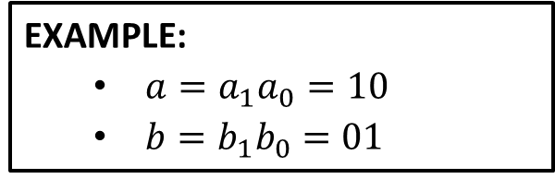
(5) Bob: Evaluate the Garbled Circuit
$$(k_{2}^{0},k_{2}^{1})$$
$$(k_{4}^{0},k_{4}^{1})$$
$$(k_{6}^{0},k_{6}^{1})$$
$$(k_{1}^{0},k_{1}^{1})$$
$$(k_{3}^{0},k_{3}^{1})$$
$$(k_{5}^{0},k_{5}^{1})$$
$$(k_{8}^{0},k_{8}^{1})$$
$$(k_{9}^{0},k_{9}^{1})$$
$$(k_{7}^{0},k_{7}^{1})$$
$$(k_{10}^{0},k_{10}^{1})$$
$$(k_{11}^{0},k_{11}^{1})$$
$$(k_{12}^{0},k_{12}^{1})$$
$$(k_{13}^{0},k_{13}^{1})$$
EXAMPLE:
$a=a_{1}a_{0}=10$
$b=b_{1}b_{0}=01$
$$(k_{15}^{0},k_{15}^{1})$$
$$(k_{14}^{0},k_{14}^{1})$$
$$(k_{16}^{0},k_{16}^{1})$$

Slide 21
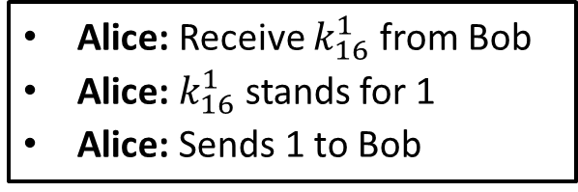
(6) Alice: Decide the Output
$$(k_{2}^{0},k_{2}^{1})$$
$$(k_{4}^{0},k_{4}^{1})$$
$$(k_{6}^{0},k_{6}^{1})$$
$$(k_{1}^{0},k_{1}^{1})$$
$$(k_{3}^{0},k_{3}^{1})$$
$$(k_{5}^{0},k_{5}^{1})$$
$$(k_{8}^{0},k_{8}^{1})$$
$$(k_{9}^{0},k_{9}^{1})$$
$$(k_{7}^{0},k_{7}^{1})$$
$$(k_{10}^{0},k_{10}^{1})$$
$$(k_{11}^{0},k_{11}^{1})$$
$$(k_{12}^{0},k_{12}^{1})$$
$$(k_{13}^{0},k_{13}^{1})$$
Alice: Receive $k_{16}^{1}$ from Bob
Alice: $k_{16}^{1}$ stands for 1
Alice: Sends 1 to Bob
$$(k_{15}^{0},k_{15}^{1})$$
$$(k_{14}^{0},k_{14}^{1})$$
$$(k_{16}^{0},k_{16}^{1})$$

Slide 22
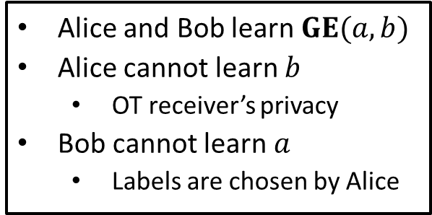
Analysis
$$(k_{2}^{0},k_{2}^{1})$$
$$(k_{4}^{0},k_{4}^{1})$$
$$(k_{6}^{0},k_{6}^{1})$$
$$(k_{1}^{0},k_{1}^{1})$$
$$(k_{3}^{0},k_{3}^{1})$$
$$(k_{5}^{0},k_{5}^{1})$$
$$(k_{8}^{0},k_{8}^{1})$$
$$(k_{9}^{0},k_{9}^{1})$$
$$(k_{7}^{0},k_{7}^{1})$$
$$(k_{10}^{0},k_{10}^{1})$$
$$(k_{11}^{0},k_{11}^{1})$$
$$(k_{12}^{0},k_{12}^{1})$$
$$(k_{13}^{0},k_{13}^{1})$$
Alice and Bob learn $GE(a,b)$
Alice cannot learn $b$
OT receiver’s privacy
Bob cannot learn $a$
Labels are chosen by Alice
$$(k_{15}^{0},k_{15}^{1})$$
$$(k_{14}^{0},k_{14}^{1})$$
$$(k_{16}^{0},k_{16}^{1})$$

